Slide 1

Fiscal Year End: 2016-17
Washougal School District
Date: November 14, 2017
Prepared by:
Larry Mayfield
Business Services Director

Slide 2
Fiscal Year End: 2016-17
Washougal School District
District Funds
General Fund
Capital Projects Fund
Debt Service Fund
Associated Student Body (ASB) Fund
Transportation Vehicle Fund

Slide 3
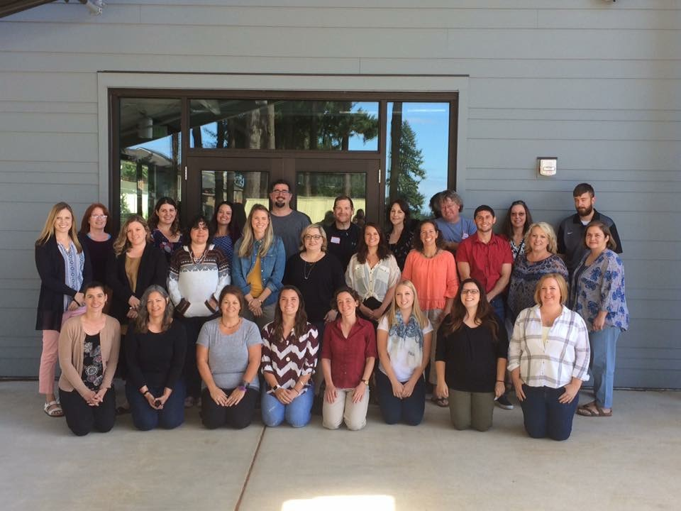

Fiscal Year End: 2016-17
Washougal School District
General Fund – Key Factors that Drive Budget
Enrollment
Staffing

Slide 4
Fiscal Year End: 2016-17
Washougal School District
Enrollment/Staffing
 | 2016-17 Budget | 2016-17 Actual | Difference
Grades K-12 | 3,032 | 3,056.38 | 24.38
Running Start | 85 | 93.36 | 8.36
Reengagement | 7 | 3.60 | (3.40)
ALE | 9 | 0 | (9.00)
Total K-12 | 3,133 | 3,153.34 | 20.34
9-12 CTE Enrollment | 170 | 181.09 | 11.09
7-8 CTE Enrollment | 40 | 44.60 | 4.60
Cert Staff | 206.273 | 199.738 | (6.535)
Notes:
K-12 0.80% incr
CIS. .500. Cnlsr. Must have hired a few after Oct 1st.
2.400 Tchrs. 01
.300 Tcher. 51
.600. Tchr 52
3.800

Slide 5
Fiscal Year End: General Fund 2016-17
Washougal School District
Notes:
Attributable to FB reductions $263,712 less than budget

Slide 6
Fiscal Year End: General Fund 2016-17
Washougal School District
Notes:
Attributable to FB reductions ($858,454) less than budget

Slide 7
Fiscal Year End: General Fund 2016-17
Washougal School District
Notes:
Explain decline in FB as %ages
Explain Transfer to CPF

Slide 8
Fund Balance Summary: General Fund 2016-17
Washougal School District
$ 159,995
109,912
735,279
2,140,124
3,040,985
$ 6,186,296
Non Spendable Fund Balance (Inventory & Prepaid)
Restricted for Carryover (LAP & CTE)
Assigned to Other Purposes
Unassigned - Minimum Fund Balance Policy (6%)
Unassigned Fund Balance
Total Fund Balance
Notes:
Provide % of Total Exp

Slide 9
Revenues General Fund 2016-17
Washougal School District
Notes:
----- Meeting Notes -----
M&O Levy/LEA $
State General $
State Special $
Federal $
Other $

Slide 10
Revenues: General Fund 2016-17
Washougal School District
Notes:
Levy + LEA 20% 18% Levy 2% LEA
----- Meeting Notes (8/27/13 13:15) -----
M&O Levy/LEA $5,786,438
State General $15,986,072
State Special $4,195,976
Federal $3,069,192
Other $799,463

Slide 11
Expenditures: General Fund 2016-17
Washougal School District
Notes:
Cert, Class Sal & Ben = $____________
Cert Salaries
Class Salaries
Benefits
Supplies
Purchased Services
Travel
Capital Purchases

Slide 12
Expenditures: General Fund 2016-17
Washougal School District
Notes:
Cert, Class Sal & Ben % + Contracted Salaries
----- Meeting Notes -
24,348,255 Salaries/Benefits
1,579,853 Supplies/Materials
3,536,843 Purchased Services
77,145 Travel 48,545 Capital Purchases
29,590,641

Slide 13
Capital Projects Fund:
Washougal School District
Notes:
Explain
State Match
Op Transfer
Bond Sale
Ending F.B.

Slide 14
Debt Service Fund:
Washougal School District

Slide 15
ASB Fund:
Washougal School District

Slide 16
Transportation Vehicle Fund:
Washougal School District
Notes:
Bot _________ Buses

Slide 17

Fiscal Year End: 2016-17
Washougal School District
Questions, Comments, Discussion

